Slide 1
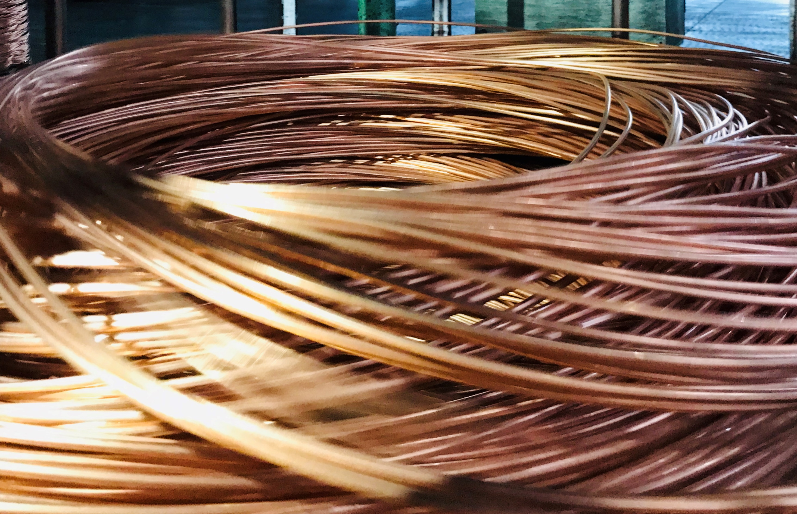
Recycled Copper Use and the Circular Economy: Drivers and Barriers

Slide 2
Antitrust Guidelines for Copper Industry Trade Association Meetings
The following guidelines with respect to compliance with antitrust laws of the United States, Japan and European Community¹ are intended to govern the conduct of participants in copper industry trade association meetings, both at the meeting itself and in informal discussions before or after the formal meeting.
Price: Competitors should not discuss future prices (including terms of sale) of their products. There is no blanket prohibition against the mention of or reference to current or past prices but limits must be observed. Such references or mentions should occur only when necessary in connection with the development of association programs. For example, reference to a particular price level in comparing the cost of a copper product to a competing product is permitted. Whenever possible, such references should be discussed in advance with legal counsel.
Competitive Information: Competitors should not discuss the market share of a particular copper producer or copper fabricator’s products. Furthermore, nothing should be said at a meeting which could be interpreted as suggesting prearranged market shares for such products or producer production levels. The overall market share of copper products may be discussed with regard to competition with non-copper products and general market acceptance.
New Products: Competitors should not encourage or discourage the introduction of a new product by another competitor or reveal a particular copper company’s plans to change the production rate of an existing product or to introduce a new product. No company should disclose to another company whether it is in a position to make or market a new product. New products may be discussed in a technical manner or from the standpoints of competition with non-copper products and general market acceptance. In addition, proposed methods for and results of field and laboratory testing can be considered.
The Role of Legal Counsel: Legal counsel attends association meetings to advise association staff and other meeting attendees regarding the antitrust laws and to see that none of the matters discussed or materials distributed raise even the appearance of antitrust improprieties. During the course of a meeting, if counsel believes that the discussion is turning to a sensitive or inappropriate subject, counsel will express that belief and request that the attendees return the discussion to a less sensitive area.
A paper entitled ‘Copper Industry Trade Associations and Antitrust Laws’ is available upon request.
10/92, 5/93, 10/10
1. Other foreign competition laws apply to International Copper Association, Ltd. ICA’s activities worldwide.
Notes:
TO CHANGE

Slide 3
Drivers for scrap copper use
Cost was reported as the key driver for the current and future use of scrap copper.
Key motivators for scrap use
Drivers for increased scrap use

Slide 4
Barriers to scrap copper use
The demand for high purity semiconductors and end products limits the use of copper scrap. While the outlook for copper recycling is generally positive, there are potential supply issues.
Factors limiting use of scrap
Common setbacks in scrap purchasing
Views on short-term demand for copper products with recycled content

